Slide 1
GENERALIZED SIMPLEX ALGORITHM

Slide 2
The (primal) simplex algorithm starts feasible but nonoptimal.
The dual simplex starts better optimal and infeasible.
If a Linear Programming model starts both nonoptimal and infeasible, a new simplex algorithm can be developed based on tandem use of the dual simplex and the primal simplex methods. First, use the dual algorithm to get rid of infeasibility. Once feasibility is restored, the primal simplex can be used to find the optimum.
Alternatively, we can first apply the primal simplex to secure optimality and then use the dual simplex to seek feasibility.

Slide 3
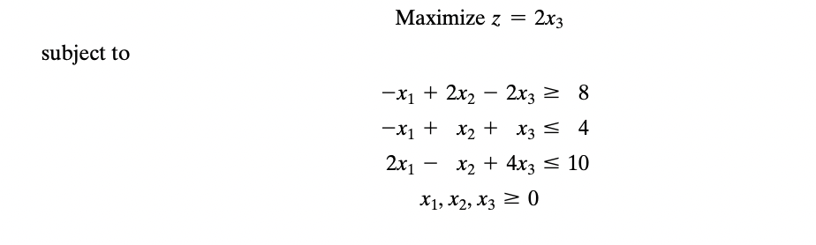
QUESTION

Slide 4
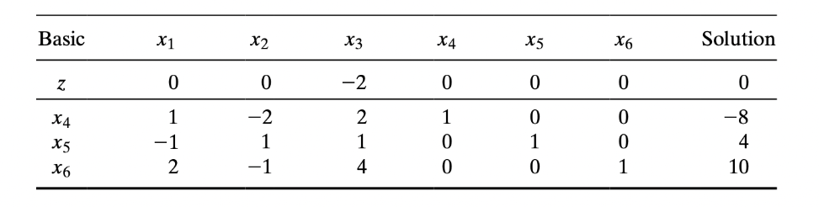
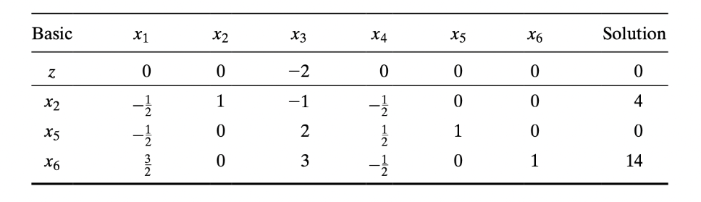
Dual Simplex (To get feasible)

Slide 5
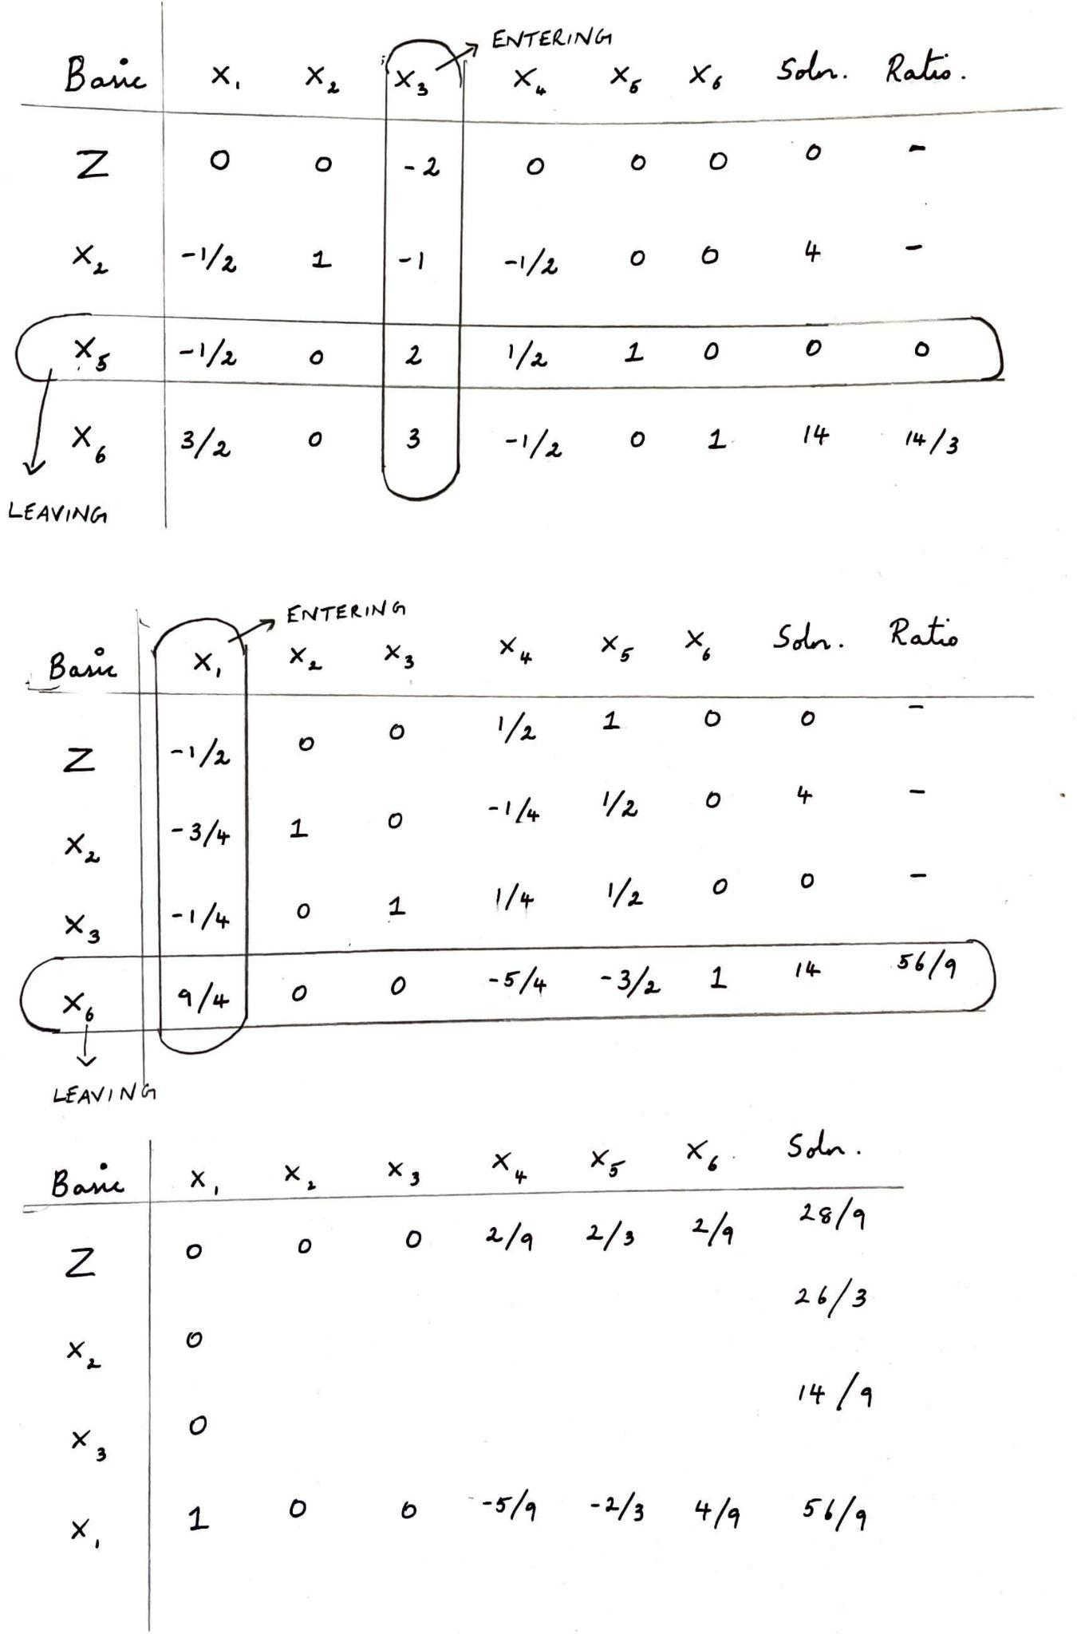
PRIMAL SIMPLEX (To get optimal)

Slide 6
ITERATION 1

Slide 7
ITERATION 2
Thus, we have attained the feasible (non-optimal) solution first using dual simplex method and then gone on to perform primal simplex method to get the optimal solution.

Slide 8
THANK YOU

